Slide 1
Motor Neuron Disease Dr Jane Haley Director of Research, MND Scotland

Slide 2
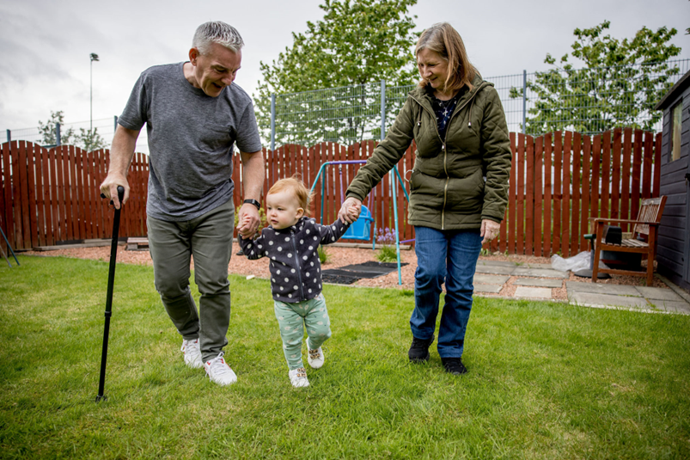
MND is brutal and often fast
1 in 300
Lifetime risk of developing MND
200
people in Scotland are diagnosed each year
18 months
average life expectancy after diagnosis
Because the average life expectancy is so short there are around
450 people living with MND in Scotland at any one time
MND Scotland: Making Time Count
MND Scotland is the only charity in Scotland providing support for people with MND.
We have also been funding research since the 1980’s
Notes:
Motor neuron disease (MND) is the general name given to a group of illnesses which affect nerves called motor neurons in the brain and spinal cord. In a healthy person, the motor neurons carry signals from the brain directly to the muscles. But if you’re living with MND, the disease can prevent these signals from reaching your muscles. Over time, this can lead to muscles becoming weaker and weaker until they stop working. This can affect the way your body works. MND is a progressive, life-shortening illness, and there is currently no cure for the disease. However, symptoms can be managed to help you live the best quality of life possible and make memories with your loved ones.

Slide 3
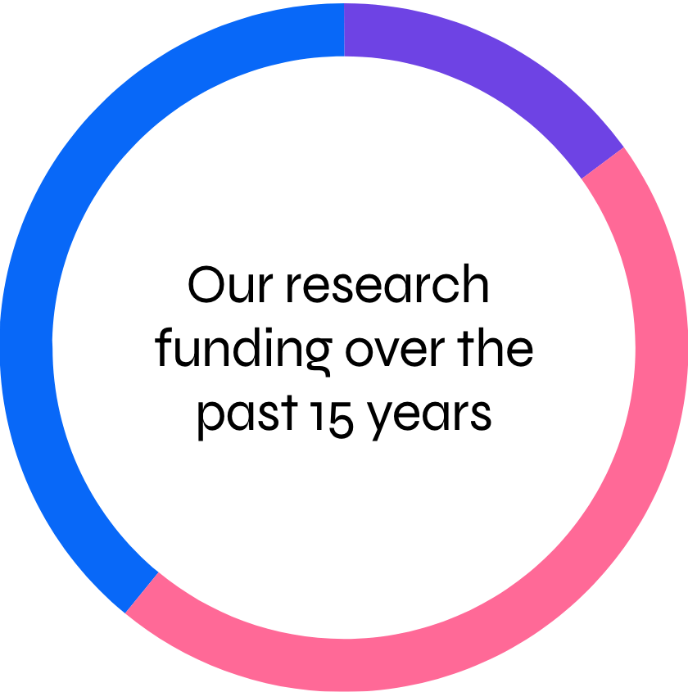
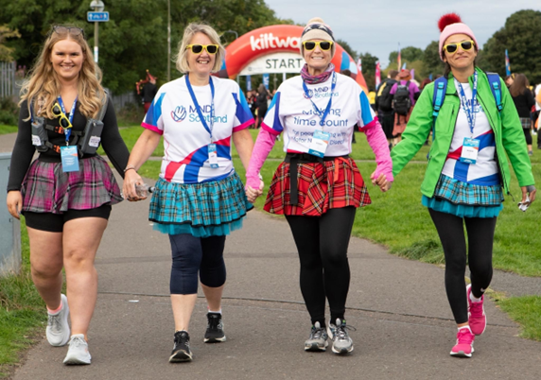
Funding research for a better future
£8.7 million across 54 projects in Scotland and the UK
58% Treatment pipeline: taking potential treatments into people, including clinical trials
33% Identifying targets for therapies and mechanisms underlying MND
9% Improving care to increase quality of life for people affected by MND
What we have funded since 2007
We fundraise to change lives today and bring hope for the future

Slide 4
MND: What is needed?
Meaningful treatments
To slow progression and stop the disease
Quick and accurate diagnosis
To allow for early treatment
Unique biomarkers
To improve clinical trial monitoring and aid personalised treatments
Better symptom management
To improve quality of life

Slide 5
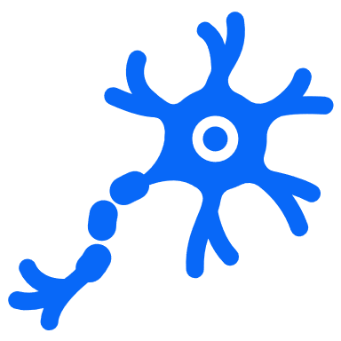
How is Scotland contributing?
Meaningful treatments
Terazosin – from fish to feasibility study in people
2009 – 2012
PhD studentship to Dr Catherina Becker, UoE
2010 – 2013
PhD studentship to Dr Tom Gillingwater, UoE
2017 – 2020
Research project to Prof Tom Gillingwater, UoE
2022 – 2025 (My Name’5 Doddie Foundation)

Slide 6
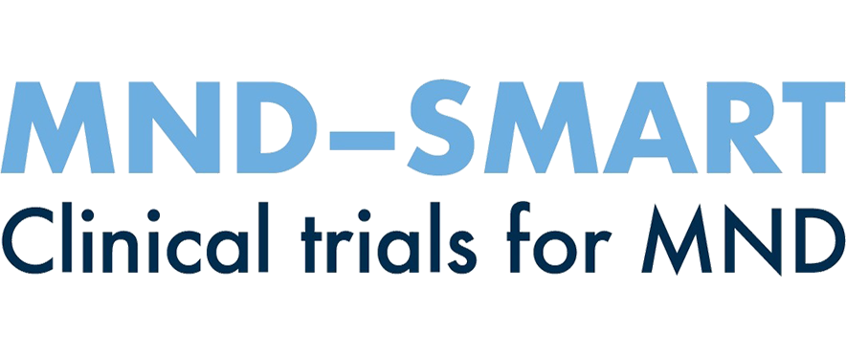
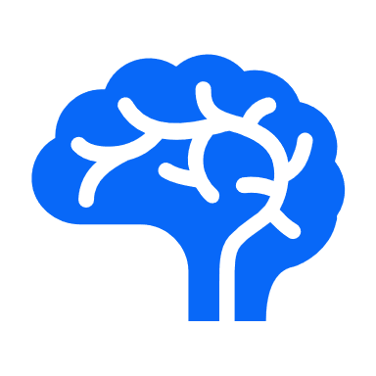
How is Scotland contributing?
Meaningful treatments
MND-SMART: a platform trial for speeding up identification of new treatments for MND
2018 – 2023
PhD studentship to Prof Siddharthan Chandran, UoE
2023 – 2028
PhD studentship to Prof Suvankar Pal, UoE
Uses vital Scottish infrastructure: CARE-MND!

Slide 7
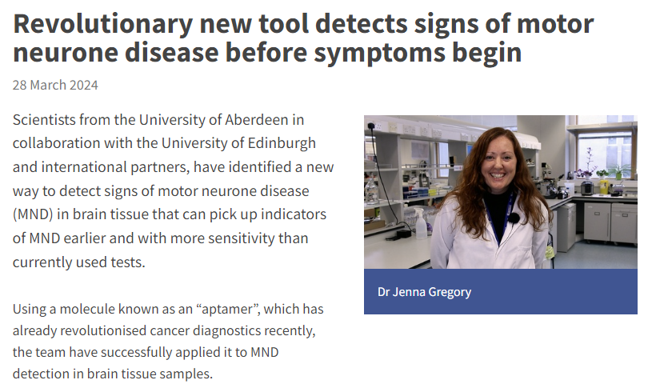
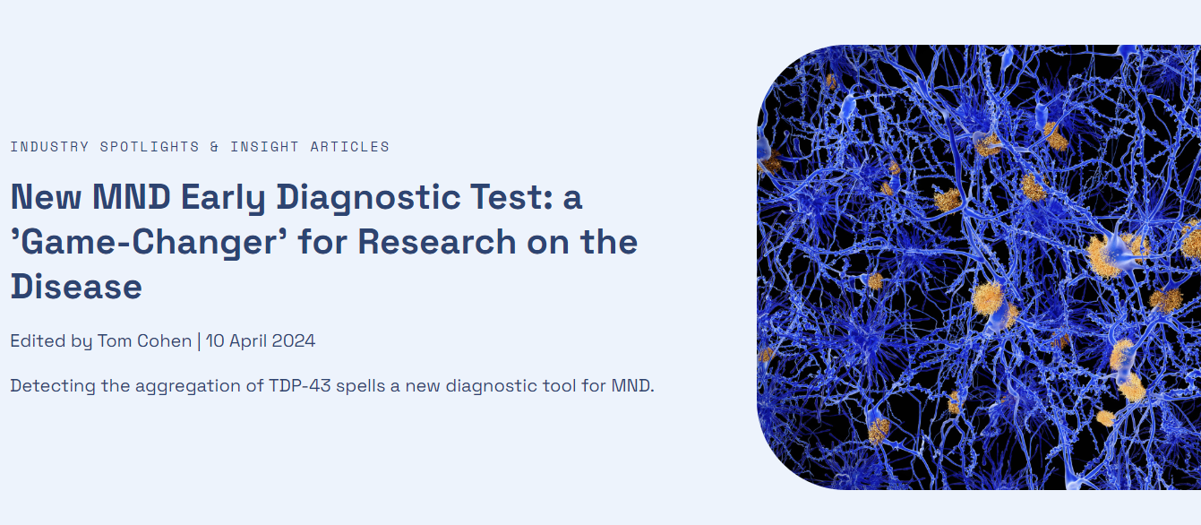
How is Scotland contributing?
Quick and accurate diagnosis
RNA Aptamers for early detection?
Uses vital Scottish infrastructure: Edinburgh Brain Bank!
Dr Jenna Gregory, University of Aberdeen

Slide 8
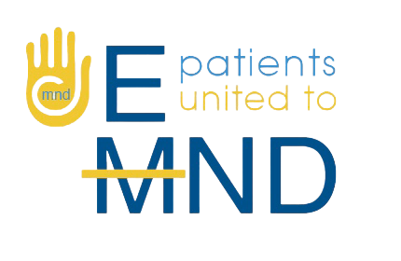
Collaborative working for a productive future
Working together to establish the UK MND Research Institute
£4.25 million committed in 2022 (£250,000 from MND Scotland). Launched in Summer 2023
Co-funding to enable (research is expensive)
60% of projects funded by MND Scotland since 2022 are co-funded with a partner. We currently have 6 different co-funding partners.

Slide 9
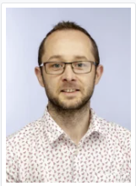
Collaborative working for a productive future
Sharing overlapping knowledge and skill
Dementia Research Institute and Dementia Platform UK are working with MND researchers to help speed up progress
Understanding mechanism
Harnessing big data
Dementia
FTD-MND
C9orf72
Prof Sharon Abrahams, University of Edinburgh
Developed Edinburgh Cognitive and Behavioural ALS Screen (ECAS)
MND
Dr Chris Henstridge, University of Dundee
Using high-resolution array tomography imaging
Uses vital Scottish infrastructure: Edinburgh Brain Bank!

Slide 10
Bringing new treatments to patients - should we be concerned?
Tofersen
[SOD1 MND antisense oligonucleotide]
MHRA – not presented yet……. Because…
NICE – route decision ruled SOD1 is not a sub-type of MND
Company
MHRA
Authorizing use in UK
Agreeing to NHS provision in England, Wales and Northern Ireland
NICE
SMC
Agreeing to NHS provision in Scotland

Slide 11
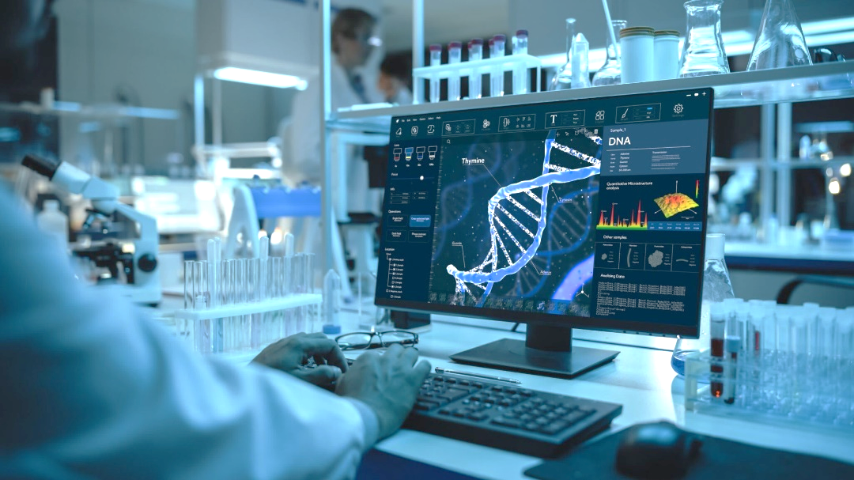
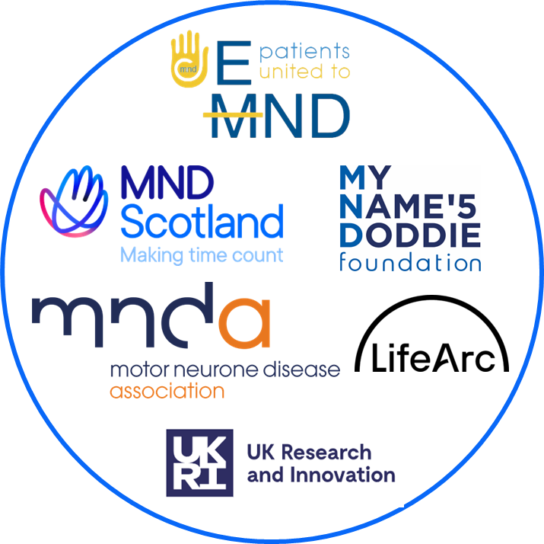
The research landscape is bright
We know much more about MND biology,
There is much more interest in the condition,
More money is being invested in MND research by charities and the government (much less than cancer or dementia)
More researchers are working in this area, and they are working more collaboratively,
We have more clinical trials, and more people can participate in them,
The charities are working together, along with government funders, to enable high quality research.

Slide 12
Thank you More at mndscotland.org.uk
Please reach out to me if you have been affected any content in this presentation Jane.Haley@mndscotland.org.uk
Making time count for people with motor neuron disease (MND)

